Slide 1

Code Verification
Manufactured Solutions

Slide 2
Manufactured Solution Definition
Central Premise:
Take the original equation and modify it to get a desired solution ^{[1]}.
Boundary conditions are then assumed from the solution
Term generated by Oberkampf and Blottner ^{[2]}
It may be helpful to remember that the goal is to test the methods/math, not the actual representation of the PDE case

Slide 3
Manufactured Solution Definition
Central Premise:
Take the original equation and modify it to get a desired solution ^{[1]}.
Boundary conditions are then assumed from the solution
Term generated by Oberkampf and Blottner ^{[2]}
It may be helpful to remember that the goal is to test the methods/math, not the actual representation of the PDE case

Slide 4
Manufactured Solution Steps
From Roy ^{[1]}:
Choose the form of the governing equations
Choose the form of the manufactured solutions
Derive the modified governing equations
Solve the discrete form of the modified governing equations on multiple meshes
Evaluate the global discretization error in the numerical solution
Apply the order of accuracy test to determine if the observed order of accuracy matches the formal order of accuracy
ie: take the altered equation and determine that it will meet the same convergence verification

Slide 5


Practical Example of Manufactured Solutions
Homework #2 problem:
$$\frac{∂T}{∂t}=\frac{∂^{2}T}{{∂T}^{2}}$$
T_{b}
T_{b}
Manufactured solution:
$$\frac{∂T}{∂t}=\frac{∂^{2}T}{{∂T}^{2}}+\frac{Q}{ρ c_{p}}$$
T_{b}
T_{b}
Q

Slide 6
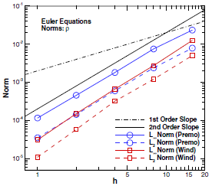

Verification Standard of a Manufactured Solution
Error can measured in norms:
$$L_{∞}\left(k\right)=max\left(u_{i}\left(k\right)−u_{i,exact}\right)$$
Bounding/maximum norm
$$L_{2}\left(k\right)=\frac{\left\|u_{i}\left(k\right)−u_{i,exact}\right\|}{\sqrt{N}}$$
Normalized magnitude norm
These norms lead to the order accuracy:
$$P=\frac{ln\left({L\left(k+1\right)}/{L\left(k\right)}\right)}{ln\left(r\right)}$$
Order of Accuracy
Convergence Plot. Originally Fig 3 from ^{[1]}.
Becomes slope of

Slide 7
Other Notes on Manufactured Solution Verification
Method is sensitive to errors in discretization
As much an advantage as disadvantage
Is insensitive to non-linearity
Insensitive to finite method
Is however code-intrusive
May not be as usable for pre-built codes
Does not handle discontinuities well

Slide 8
Code Verification
Alternative Means

Slide 9
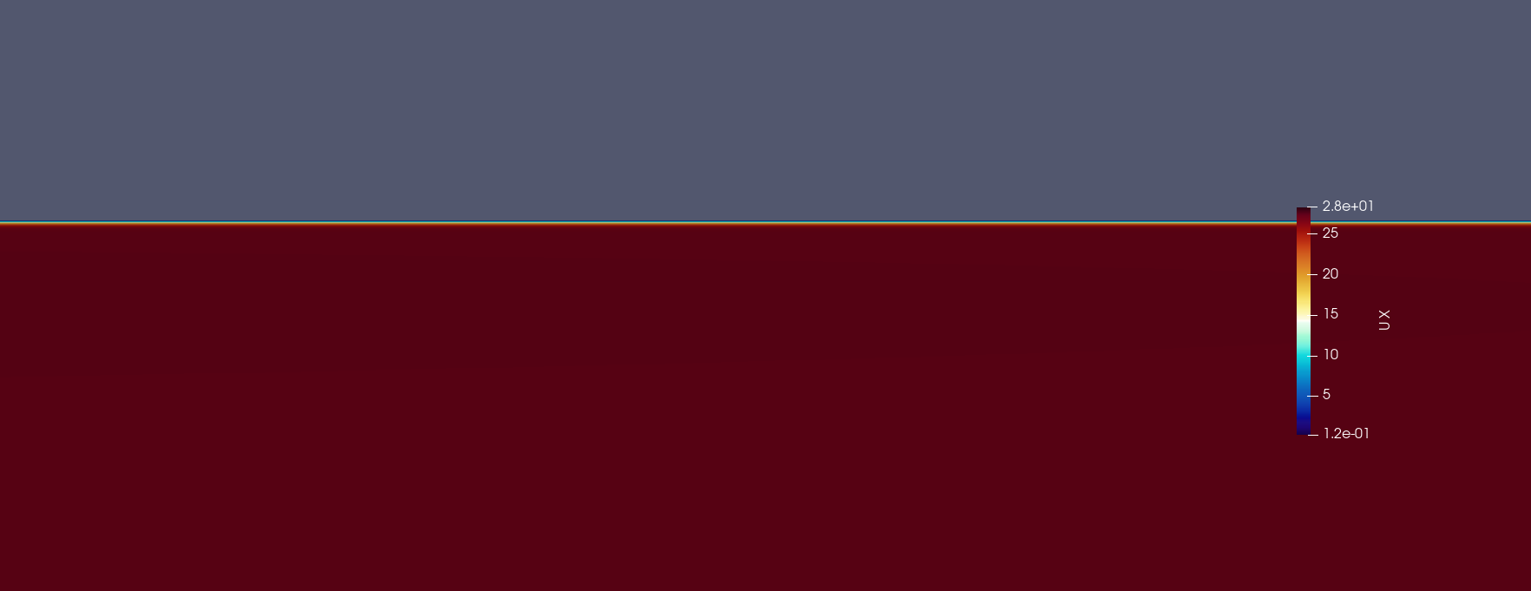
Canonical Verification/Validation
Comparing the solution to an accepted canon case can verify the code
Roy gives the example of the Blasius solution for the boundary layer
Cases can be as complex/simple as the model requires
Blasius Solution

Slide 10
Code-to-Code Verification
The code may be compared to other solver codes
The user must be very careful to draw a valid comparison

Slide 11
Works Cited
Roy, C. J. (2005). Review of code and solution verification procedures for computational simulation. Journal of Computational Physics. Vol 205, pgs 131-156. DOI: 10.1016/j.jcp.2004.10.036
Oberkampf, W. L. and Blottner, F. G. (1997). Issues in Computational Fluid Dynamics Code Verification and Validation. Sandia National Laboratories. SAND95-1352.

